Slide 1
Minimum Spanning Tree
Kruskal’s Algorithm

Slide 2
Last Class’s Topic
Minimum Spanning Tree (Prim’s Algorithm)
  What is spanning tree & Minimum spanning tree?
  What will happen if we add an edge in a minimum spanning tree?
Read the following topics from “Cormen-pg563”
  Cut
  Cross
  Light edge

Slide 3
Some Definition
Cut:
  Partition of V. Ex: (S, V-S)
Cross:
  Edge (u,v) crosses the cut (S, V-S) if one of its endpoints is in S and the other is in V-S.
Light edge:
  An edge crossing a cut if its weight is the minimum of any edge crossing the cut.

Slide 4
Kruskal's Algorithm
Edge based algorithm
Add the edges one at a time, in increasing weight order
The algorithm maintains A – a forest of trees. An edge is accepted it if connects vertices of distinct trees
We need a data structure that maintains a partition, i.e.,a collection of disjoint sets
  MakeSet(S,x)
  Union(S_{i},S_{j})
  FindSet(S, x)

Slide 5
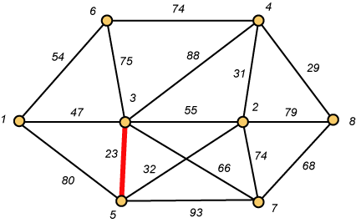
Kruskal – Step 1

Slide 6
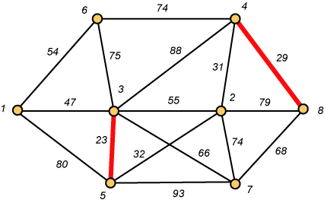
Kruskal – Step 2

Slide 7
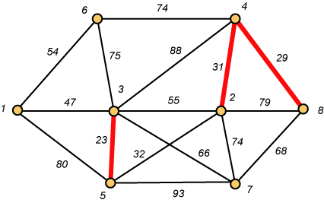
Kruskal – Step 3

Slide 8
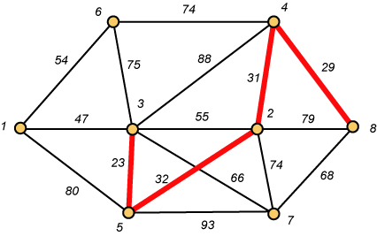
Kruskal – Step 4

Slide 9
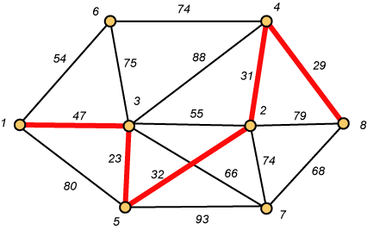
Kruskal – Step 5

Slide 10
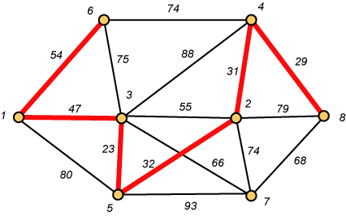
Kruskal – Step 6

Slide 11
Why Avoiding Cycles Matters
Up to this point, we have simply taken the edges in order of their weight. But now we will have to reject an edge since it forms a cycle when added to those already chosen.

Slide 12
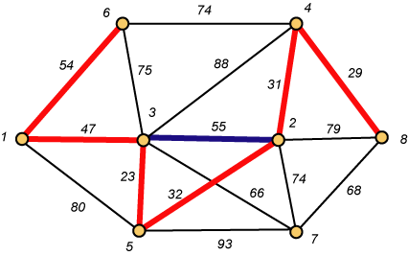
Forms a Cycle
So we cannot take the blue edge having weight 55.

Slide 13
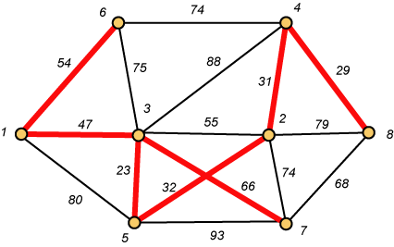
Kruskal – Step 7 DONE!!
Weight (T) = 23 + 29 + 31 + 32 + 47 + 54 + 66 = 282

Slide 14
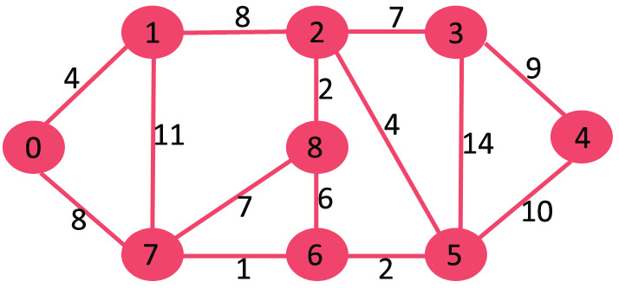
Exercise

Slide 15
Disjoint-Set
Keep a collection of sets S₁, S₂, .., S_{k},
  Each S_{i} is a set, e,g, S₁={v₁, v₂, v₈}.
Three operations
  Make-Set(x)-creates a new set whose only member is x.
  Union(x, y) –unites the sets that contain x and y, say, S_{x} and S_{y}, into a new set that is the union of the two sets.
  Find-Set(x)-returns a pointer to the representative of the set containing x.

Slide 16

Kruskal's Algorithm
The algorithm adds the cheapest edge that connects two trees of the forest
MST-Kruskal(G,w)
01 A ← ∅
02 for each vertex v ∈ V[G] do
03 Make-Set(v)
04 sort the edges of E by non-decreasing weight w
05 for each edge (u,v) ∈ E, in order by non-decreasing weight do
06 if Find-Set(u) ≠ Find-Set(v) then
07 A ← A ∪ {(u,v)}
08 Union(u,v)
09 return A
O(V)
O(ElogE)
O(E)
O(V)

Slide 17
Question
Exercise
  23.2.7 – Add new vertices & edges in a graph
  23-1: Second best minimum spanning tree

